Slide 1
International Socialist Feminism, 1884-2018
Nora Kassner | HIST 2c | Summer 2018

Slide 2
Do stay-at-home parents work?

Slide 3
Is childbirth work?

Slide 4
Should people earn money for giving birth and raising children?

Slide 6
Women’s Labor
Myth
Reality

Slide 7
Just as there is a wage gap between men and women in the workplace, there is a ‘leisure gap’ between them at home. Most women work one shift in the office or factory and a ‘second shift’ at home.
-Arlie Russell Hochschild

Slide 8
Early Marxist, Anarchist, and Socialist Feminists
1900s-1910s
Developed from Marxism (especially Engels)
Key figures: Clara Zetkin, Emma Goldman, and Alexandra Kollontai

Slide 9
The Big Idea
Women’s Economic Dependence
Sexist ideologies
Male Breadwinners
Capitalism

Slide 10
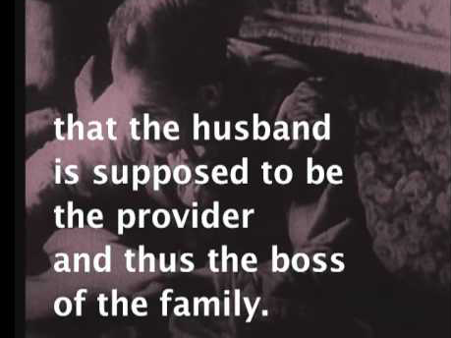
Clara Zetkin in Her Own Words:

Slide 11
Mid-Century Socialist Feminist Revolutionaries
Federacion de Mujeres Cubanas, Cuba 1961-
Mujeres Libres,
Spain, 1936
All-China Women’s Federation, 1949-1966

Slide 12
Expanding Socialist Feminism, 1970s-1980s
Continuing the transnational tradition
Creating a racial and post-colonial analysis
Addressing sexuality

Slide 13
Silvia Federici and the International Wages for Housework Campaign

Slide 14
Combahee River Collective

Slide 15
“We realize that the liberation of all oppressed peoples necessitates the destruction of the political-economic systems of capitalism and imperialism as well as patriarchy…We are not convinced, however, that a socialist revolution that is not also a feminist and anti-racist revolution will guarantee our liberation”
“As Black feminists and Lesbians we know that we have a very definite revolutionary task to perform and we are ready for the lifetime of work and struggle before us”

Slide 16
Socialist Feminism in 2018?

